Slide 1
Numeracy
Primary 1 Curriculum Evening

Slide 2
Agenda
1
What is numeracy?
2
Building a conceptual understanding of number
3
What numeracy looks like in Primary 1
4
Resources we use
5
Supporting numeracy at home
6
Homework
2

Slide 3
What is numeracy?
Numeracy is the ability to understand and use maths in everyday life.
COUNT
MEASURE
not just knowing facts, but knowing when and how to apply them
understanding numbers, counting and solving numerical problems
measuring, sorting, noticing patterns, adding and subtracting
developing skills for life, learning and work
PATTERN
SOLVE
Children’s everyday lives are full of opportunities to develop numeracy.
3

Slide 4
The foundations we are building
Early Level numeracy is about secure understanding, not racing ahead.
1
Number recognition & counting
2
Subitising
3
Number bonds
Say, read, order and write numbers; count objects accurately.
Recognise small quantities without counting one-by-one.
See how numbers can be split and recombined in different ways.
4
Addition & subtraction
5
Patterns & relationships
6
Measure, shape & data
Understand combining, taking away and finding the difference.
Spot, copy, continue and explain patterns.
Explore length, weight, time, money, shape and simple information.
4

Slide 5
We are building a
conceptual understanding
of number.
Children build, deepen and connect mathematical ideas. We look for them to explain their thinking and represent the same idea in different ways.
verbal • concrete • pictorial • abstract
The goal is not simply to remember an answer — it is to understand the number relationships underneath it.
5

Slide 6
From ‘doing’ maths to writing maths
We move through concrete → pictorial → abstract, rather than starting with a written sum.
1. Concrete
2. Pictorial
3. Abstract
→
→
5 + 3 = 8
Build it with counters,
cubes, fingers or objects.
Draw it or show it on a
ten frame / number line.
Symbols now represent
something understood.
6

Slide 7
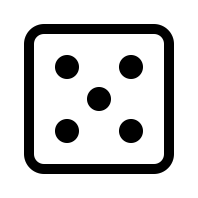
Ahmad, Younes, Zaynab, Malghalara and Thomas – extra 1:1 sessions with class teacher and support staff for set 1 sounds.§
One number — many representations
Being able to move between representations helps children understand what a number really means.
Part–whole
Take away
5
1 + 4
2 + 3
7 − 2
6 − 1
Words
Pattern
five
one more than 4
7

Slide 8
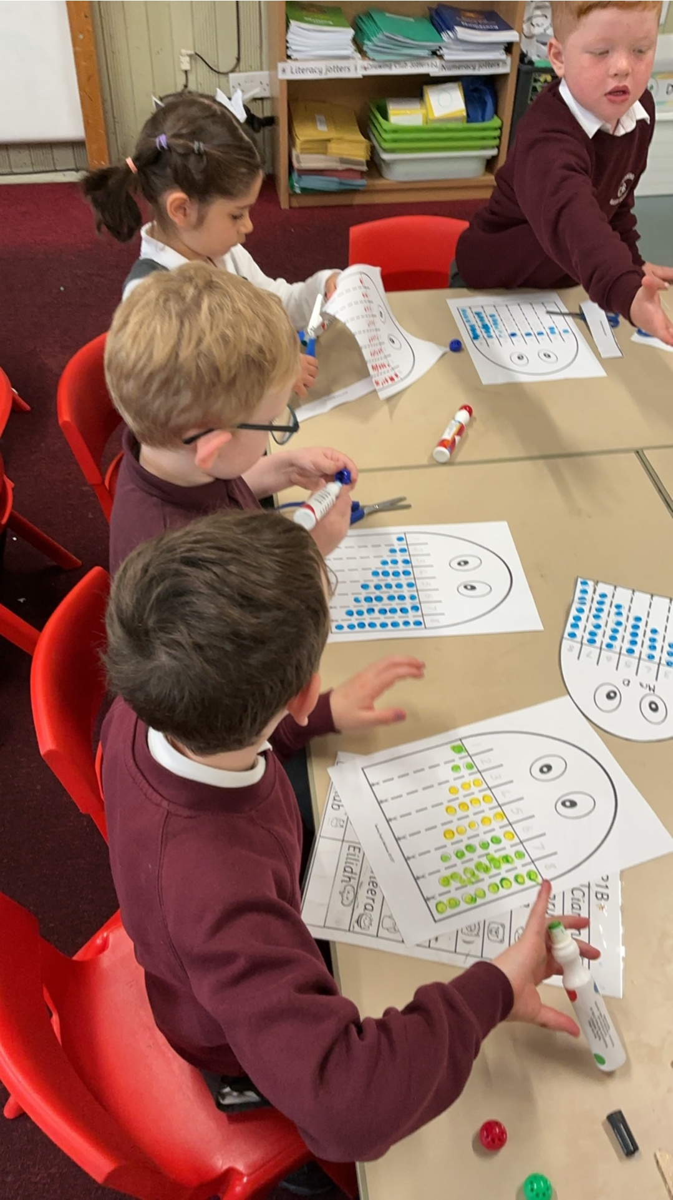
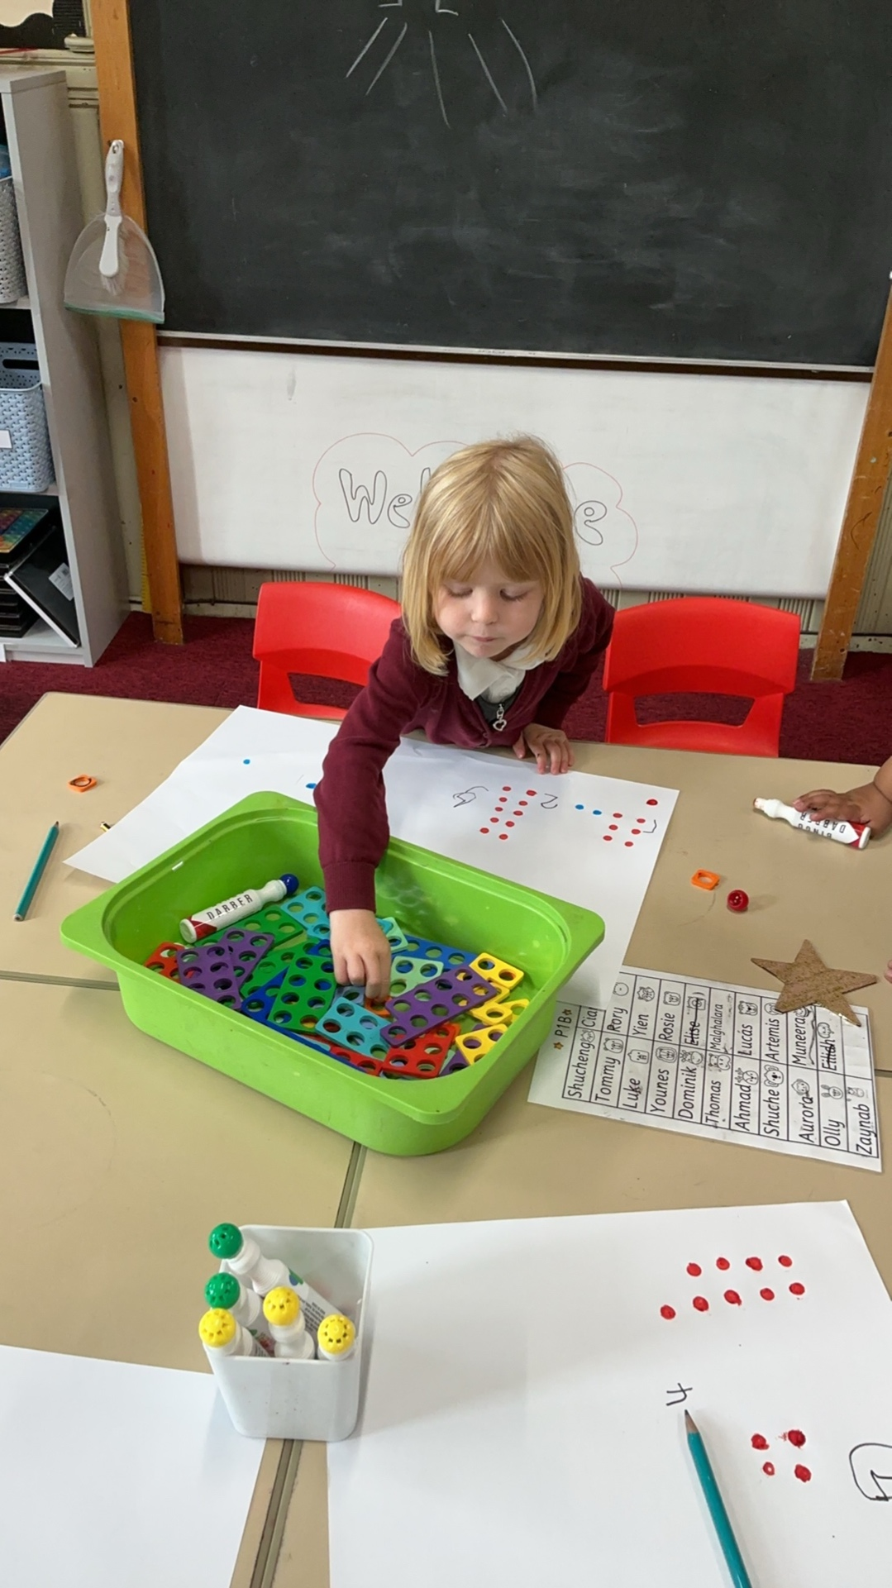
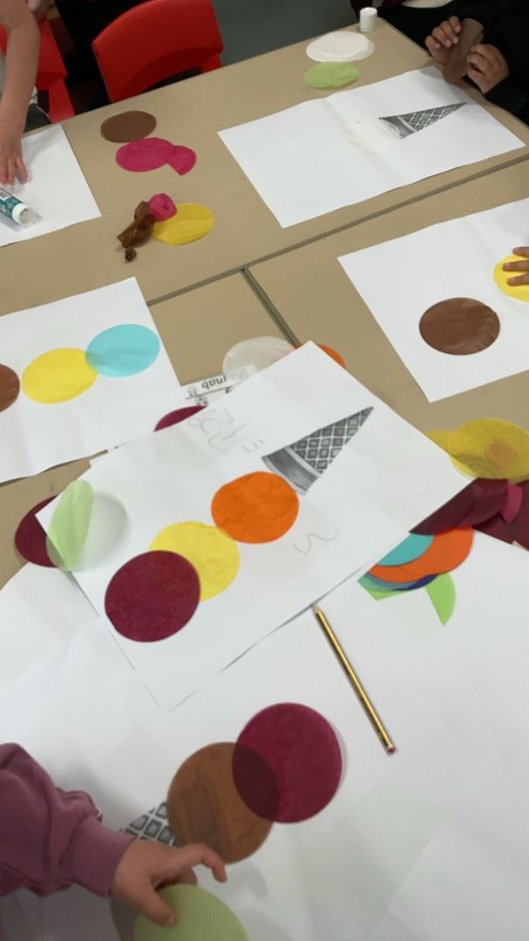
What does numeracy time in Primary 1 look like?
Around one hour every day, with a balance of teaching, practice, assessment and play.
10 mins
10 mins
Teacher table
3 Gold Stars
Mental maths
Focused carpet teaching
Focused task
Independent tasks
Quick counting, number sense and oral work
Introduce and model the day’s learning
Teacher-led learning and assessment
Children consolidate learning independently
Continuous play continues while children are completing Gold Star tasks and working at the teacher table.
8

Slide 9
What resources do we use?
1
White Rose Maths
2
Practical activities & games
3
Promethean board
structured teaching resources
hands-on ways to explore number
interactive whole-class activities
4
Songs & rhymes
5
Numicon
6
Number stories
counting, patterns and mathematical language
visual and multisensory number patterns
Oxford Owl number story books used in school
We’ll show some examples of the Oxford Owl number story books we use in school.
9

Slide 10
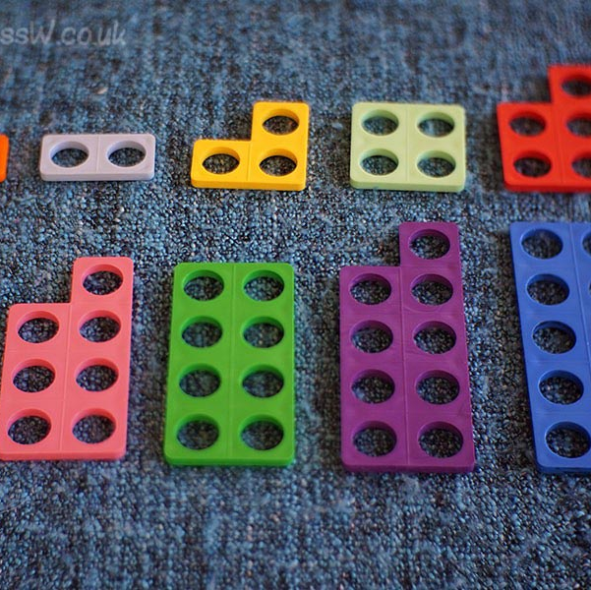
Numicon
Numicon gives children a visual image to match each number.
makes numbers and number relationships visible and tangible
uses consistent patterns to help children understand quantity
supports multisensory, oral and mental learning
encourages thinking, reasoning and confident problem solving
The pattern becomes a picture of the number.
10

Slide 11
How you can help at home
Short, relaxed, everyday maths is more valuable than long formal practice.
Numeracy in real life
Play games
Spot numbers
Counting stairs and cars for example. Weights and measures (e.g cooking)
dice, dominoes, cards, board games
doors, buses, prices, clocks
Compare
Ask ‘how?’
Make it positive
more/fewer, longer/shorter, heavier/lighter
“How did you know?” “Can you show me?”
praise effort, noticing and explaining
Five minutes woven into everyday life is enough to make a difference.
11

Slide 12
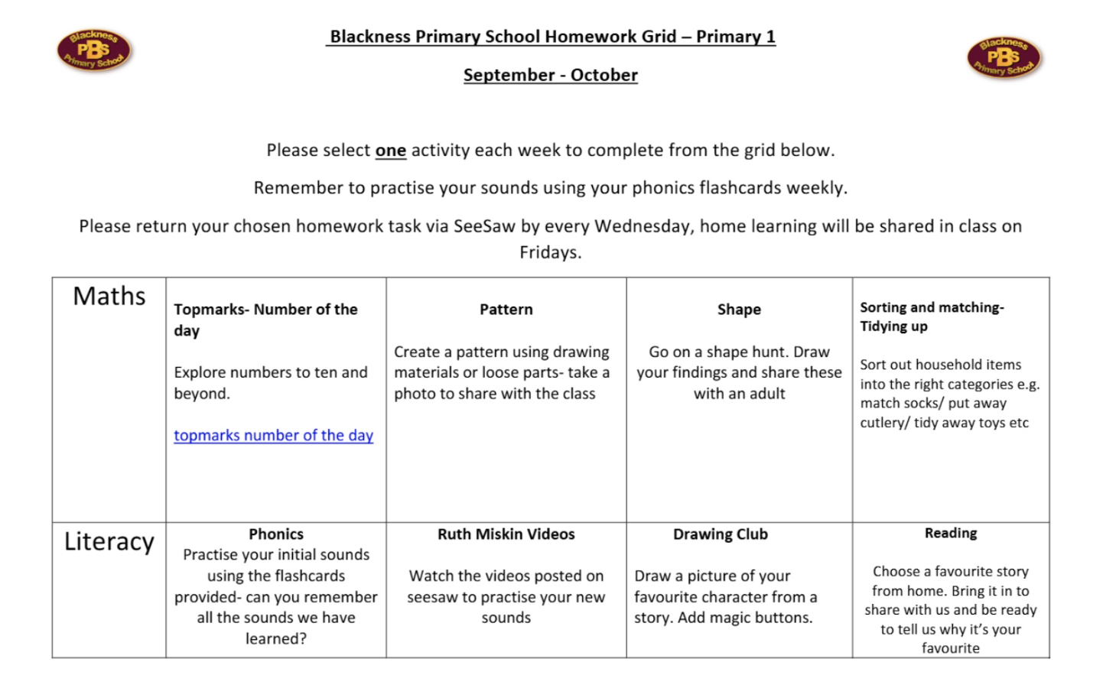
Homework
A simple way to revisit and share the learning happening in class.
Each term, children will receive a learning grid recapping the learning covered at school.
Each week, children should complete one activity.
Activities can be repeated and revisited throughout the term.
Photographs of homework should be uploaded to Seesaw so children can share their learning with their class and teacher.
12

Slide 13
Thank you
There are examples of Gold Star tasks laid out, along with some of the other resources we use to teach numeracy.
Do you have any questions?
Primary 1 Numeracy
13

